Slide 1

3.6 Fundamentals of cyber security
3.6.1.1 Social engineering
Lesson

Slide 2
Starter activity
What do the following have in common?
Hackers
Everyday people
Penetration testers
Scam artists
Data brokers
Governments
Sales people
Recruiters
Spies
Disgruntled employees
TIME UP
Start
Notes:
Click on ‘Start’ to start the three-minute timer.
Answer: They are all social engineers
Can students identify from the list what a ‘social engineer’ might be or what the term ‘social engineering’ means?

Slide 3
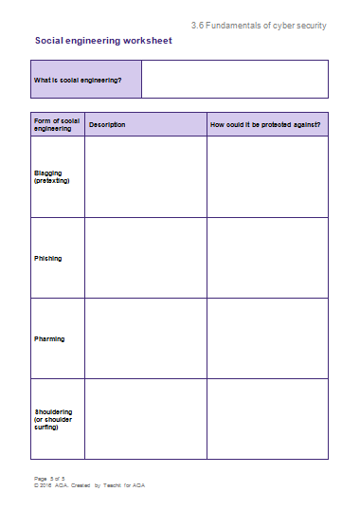
Social engineering worksheet
Complete this worksheet during the lesson.

Slide 4
Starter activity: video
What is social engineering?
social-engineer.org
Notes:
Video 1:26 minutes.
More information here: en.wikipedia.org/wiki/Social_engineering_(security)
‘Social engineering, in the context of information security, refers to psychological manipulation of people into performing actions or divulging confidential information. A type of confidence trick for the purpose of information gathering, fraud, or system access, it differs from a traditional "con" in that it is often one of many steps in a more complex fraud scheme. The term "social engineering" as an act of psychological manipulation is also associated with the social sciences, but its usage has caught on among computer and information security professionals.’

Slide 5
Discussion
Did you guess correctly?
What social engineering examples can you think of?
Can you think of an example of a threat that social engineering might pose?
In what ways could people or organisations protect themselves from social engineering?

Slide 6
Objectives
Define the term ‘social engineering’.
Describe what social engineering is and how it can be protected against.
Explain forms of social engineering.

Slide 7
Forms of social engineering
Shouldering
(or shoulder surfing)
Phishing
Blagging
(pretexting)
Pharming
Notes:
Extension task: Further reading on the topic:
bbc.co.uk/news/business-35201188
welivesecurity.com/2015/12/30/5-things-need-know-social-engineering/
Blagging (pretexting): techopedia.com/definition/13675/pretexting
“Pretexting is a social engineering technique in which a fictional situation is created for the purpose of obtaining personal and sensitive information from an unsuspecting individual. It usually involves researching a target and making use of his/her data for impersonation or manipulation. Personal data may include Social Security numbers (SSN), usernames, passwords or other privileged information.”
Phishing: en.wikipedia.org/wiki/Phishing
“Phishing is the attempt to acquire sensitive information such as usernames, passwords, and credit card details (and sometimes, indirectly, money), often for malicious reasons, by masquerading as a trustworthy entity in an electronic communication”
Pharming: uk.norton.com/cybercrime-pharming
“Pharming (pronounced ‘farming’) is a form of online fraud very similar to phishing as pharmers rely upon the same bogus websites and theft of confidential information. However, where phishing must entice a user to the website through ‘bait’ in the form of a phony email or link, pharming re-directs victims to the bogus site even if the victim has typed the correct web address. This is often applied to the websites of banks or e-commerce sites.”
Shouldering (Or shoulder surfing): techopedia.com/definition/4103/shoulder-surfing
“Shoulder surfing refers to the act of obtaining personal or private information through direct observation. Shoulder surfing involves looking over a person's shoulder to gather pertinent information while the victim is oblivious. This is especially effective in crowded places where a person uses a computer, smartphone or ATM. If shoulder surfing occurs when there are very few people, the act becomes suspicious very quickly. Binoculars, video cameras and vision-enhancing devices also are used, depending on location and situation.”

Slide 8
Blagging role-play activity
Work in pairs.
Notes:
Further reading about blagging (pretexting):
tenintel.com/analysis-article.php?id=36
theguardian.com/money/2014/oct/13/eight-things-bank-never-ask-you

Slide 9
Phishing activity
sonicwall.com/phishing/
Use this website and click on ‘Start the test’.
Can you identify phishing scams?
What is your phishing IQ?
Notes:
Optional video 3:07 minutes
youtube.com/watch?v=9TRR6lHviQc

Slide 10
Pharming activity
What is pharming?
youtube.com/watch?v=HNBvtebBv4M
Notes:
Video 2:58 minutes.

Slide 11
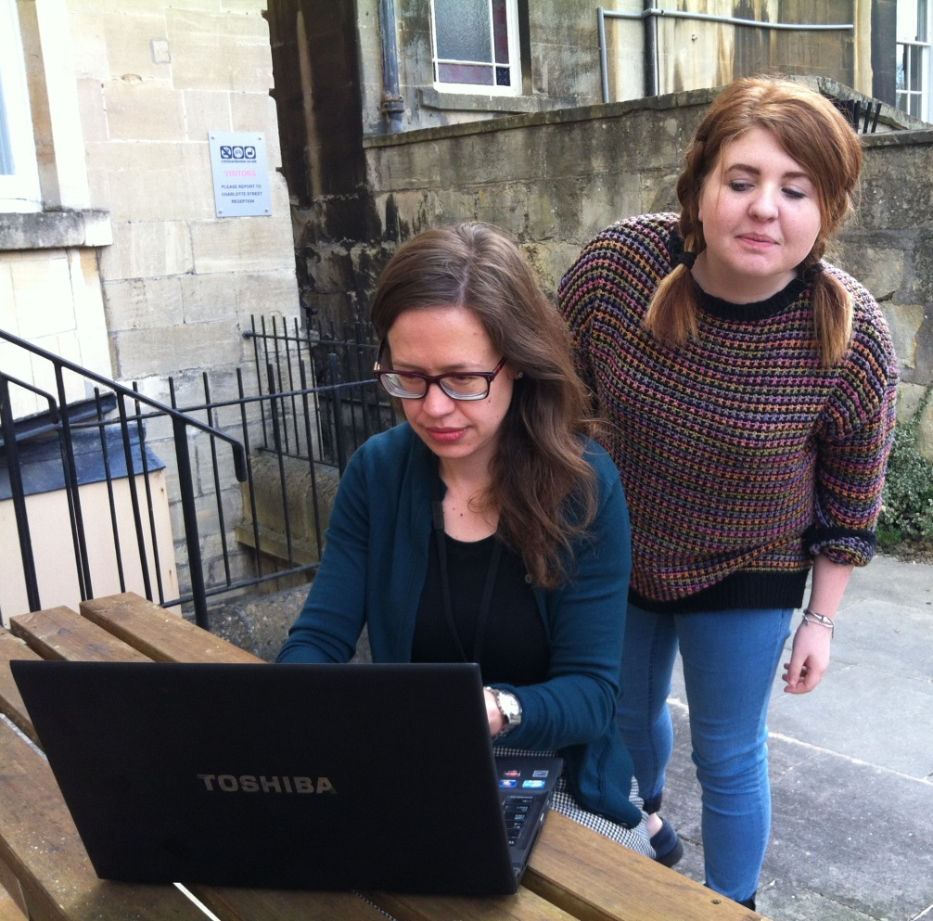
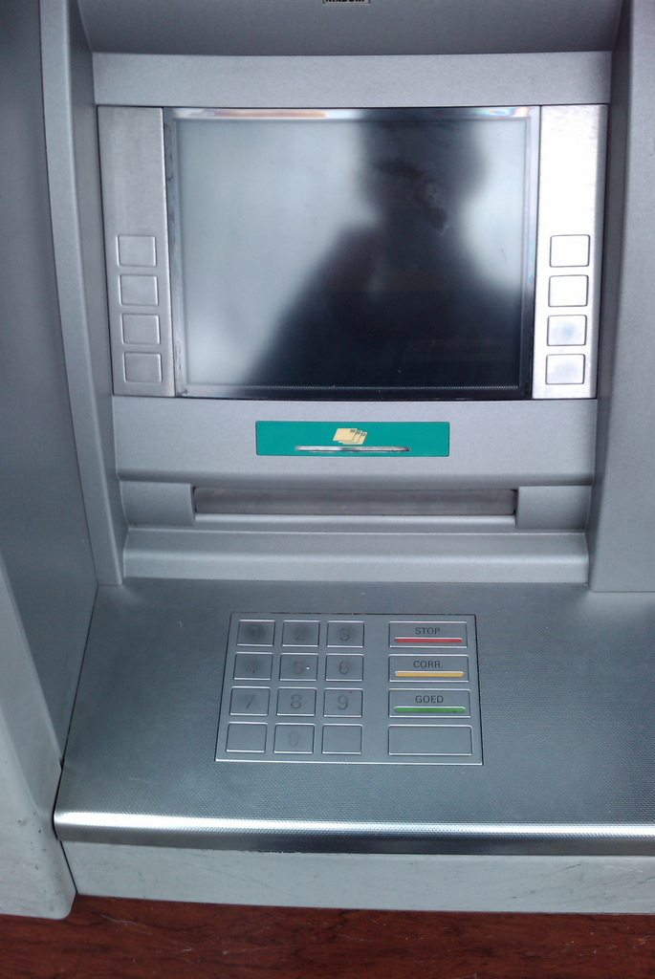
Shoulder-surfing activity
Identify the problems in these photographs.
Notes:
Image sources
Left: © Teachit, part of AQA 2016
Right: © Cuno de Boer 2009 https://flic.kr/p/6PmBWu Kindly shared under a Creative Commons licence: https://creativecommons.org/licenses/by/2.0/

Slide 12
Plenary
5, 4, 3
Identify:
5 people or organisations that may be involved in social engineering
4 forms of social engineering
3 ways to protect against social engineering.

