Slide 1

3.3 Fundamentals of data representation
3.3.1 Number bases and 3.3.3 Units of information
Lesson

Slide 2
Objectives – Number bases
Know about historical instances of data representation.
Define what is meant by a number base.
Know about the differences in magnitude between different bases.

Slide 3
Objectives – Units of information
Know that a bit is the smallest unit of data on a computer.
Know how many bits are in a byte.
Understand how to use prefixes to represent magnitude.

Slide 4
Over to you…
Quick Quiz

Slide 5
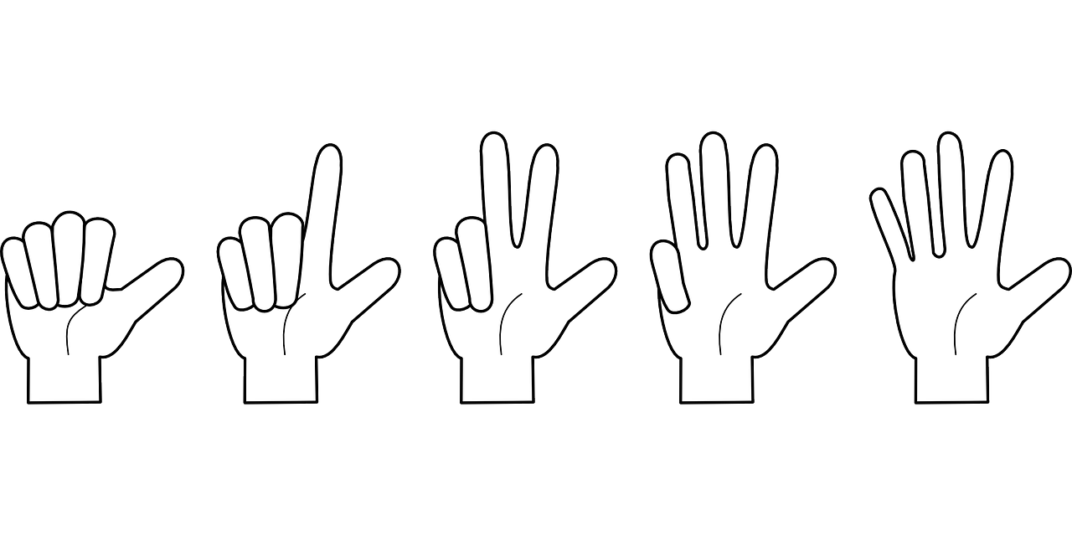
Representing numbers (3.3.1)
As human beings, we are used to counting using a Base 10 (decimal) number system.
Why do you think this might be?
Unfortunately, computers only deal in the Base 2 (binary) number system.

Slide 6
Look at the differences in the range (radix) of each column.
Binary Base 2 The counting system of a computer. | Range |  | Decimal Base 10 The counting system of humans. | Range |  | Hexadecimal Base 16 A way of representing the counting system used by computers in a more compact and easier to remember way. | Range
 |  |  |  |  |  |  |  | F
 |  |  |  |  |  |  |  | E
 |  |  |  |  |  |  |  | D
 |  |  |  |  |  |  |  | C
 |  |  |  |  |  |  |  | B
 |  |  |  |  |  |  |  | A
 |  |  |  |  | 9 |  |  | 9
 |  |  |  |  | 8 |  |  | 8
 |  |  |  |  | 7 |  |  | 7
 |  |  |  |  | 6 |  |  | 6
 |  |  |  |  | 5 |  |  | 5
 |  |  |  |  | 4 |  |  | 4
 |  |  |  |  | 3 |  |  | 3
 |  |  |  |  | 2 |  |  | 2
 |  | 1 |  |  | 1 |  |  | 1
 |  | 0 |  |  | 0 |  |  | 0
Two variations in one column |  |  | Ten variations in one column |  |  | Sixteen variations in one column
Notes:
Hexadecimal has the capacity to represent numbers more ‘compactly’ than binary.

Slide 7
How do we store numbers using a computer?
Computers store data by using single binary bits.
To represent a larger collection of numbers it is necessary to use a range of bits and to give them specific values.
One byte (a collection of eight bits) will allow us to represent a range of numbers ( 0-255₁₀).
Notes:
Computers store data by using single binary bits (i.e. one ‘column’ in binary) and this at first glance appears to allow us to store just a ‘1’ or ‘0’ value in decimal – i.e. not much!
In order for us to represent a larger collection of numbers it is necessary use a range of bits and to give them specific values – as you may have guessed already, one byte (the name given to a collection of eight bits) will allow us to represent a range of numbers ( 0-255₁₀).

Slide 8
Converting binary to decimal
Look at the binary pattern and work from right to left.
Identify whether each successive bit is ‘on’ or ‘off’ i.e. is 1 or 0 in value.
Then add up the totals.
Example |  | Convert 00101100 to decimal
0 | 0 | 1 | 0 | 1 | 1 | 0 | 0
128 | 64 | 32 | 16 | 8 | 4 | 2 | 1
Decimal total value |  |  | 32 + 8 + 4 = 44
Notes:
This subject is continued in greater detail in the next lesson in this series.

Slide 9
What is data?
When we talk about data within the context of the world of computing – we are talking about the storage of information in a binary form.
A computer can be made to encode and store whatever type of information we give it, text, pictures, sound and video as an encoded stream of ones and zeros, that’s it!
Data storage = Binary storage
Notes:
It is helpful for students to be able to interconvert between the featured number systems and the practice quizzes provided for you will help you to practice this.

Slide 10
Over to you…
Quiz 1

Slide 11
Putting a size on things (3.3.3)
In order for us to be able to give an exact magnitude to a quantity, we need two components:
the correct number system
an order of magnitude.
Unit | Represents | Comments
bit (b) | smallest possible unit of storage
byte (B) | 1 byte is a collection of 8 bits
kilo | 1000 | 1 kB = 1,000 bytes
mega | 1000000 | 1 MB = 1,000,000 bytes
giga | 1000000000 | 1 GB = 1,000,000,000 bytes
tera | 1000000000000 | 1 TB = 1,000,000,000,000 bytes

Slide 12
Over to you…
Quiz 2
Notes:
A quick test on using the different prefixes.

