Slide 1

3.6 Fundamentals of cyber security
3.6.1.2 Malicious code
Lesson

Slide 2
Starter activity: Thought shower
Create your own Wordle using this link:
wordle.net
Try to think of as many key words as possible related to the term ‘malicious code’.
TIME UP
Start
Notes:
Malware comes from the words: malicious + software
Definition of malware: onguardonline.gov/articles/0011-malware
Malware includes viruses, spyware, and other unwanted software that gets installed on your computer or mobile device without your consent. These programs can cause your device to crash, and can be used to monitor and control your online activity. They also can make your computer vulnerable to viruses and deliver unwanted or inappropriate ads. Criminals use malware to steal personal information, send spam, and commit fraud.

Slide 3
Starter activity
What key words did you include in your Wordle?
What is ‘malware’?
Could you make a definition for the term ‘malware’?
Notes:
Answer: onguardonline.gov/articles/0011-malware
Malware includes viruses, spyware, and other unwanted software that gets installed on your computer or mobile device without your consent. These programs can cause your device to crash, and can be used to monitor and control your online activity. They also can make your computer vulnerable to viruses and deliver unwanted or inappropriate ads. Criminals use malware to steal personal information, send spam, and commit fraud.

Slide 4
Discussion
Now you have a definition of malware:
What are the threats of malware?
Can you think of examples of malware?
What are the ways that malware can be protected against?
Were you right?
youtube.com/watch?v=UFPCEVgTq38
Notes:
3:14 minute video on malware – watch to the end to confirm answers.
youtube.com/watch?v=UFPCEVgTq38

Slide 5
Objectives
Define the term ‘malware’.
Describe what malware is and how it can be protected against.
Describe forms of malware.

Slide 6
Forms of malware
Spyware
Trojan
Computer virus
Adware
Notes:
Computer virus: en.wikipedia.org/wiki/Computer_virus
A computer virus is a malware program that, when executed, replicates by inserting copies of itself (possibly modified) into other computer programs, data files, or the boot sector of the hard drive; when this replication succeeds, the affected areas are then said to be "infected".Viruses often perform some type of harmful activity on infected hosts, such as stealing hard disk space or CPU time, accessing private information, corrupting data, displaying political or humorous messages on the user's screen, spamming their contacts, logging their keystrokes, or even rendering the computer useless. However, not all viruses carry a destructive payload or attempt to hide themselves—the defining characteristic of viruses is that they are self-replicating computer programs which install themselves without user consent.
Trojan: usa.kaspersky.com/internet-security-center/threats/trojans#.VwDkkFKDClI
A Trojan horse or Trojan is a type of malware that is often disguised as legitimate software. Trojans can be employed by cyber-thieves and hackers trying to gain access to users' systems. Users are typically tricked by some form of social engineering into loading and executing Trojans on their systems. Once activated, Trojans can enable cyber-criminals to spy on you, steal your sensitive data, and gain backdoor access to your system. These actions can include: deleting data, blocking data, modifying data, copying data and disrupting the performance of computers or computer networks. Unlike computer viruses and worms, Trojans are not able to self-replicate.
Spyware: bbc.co.uk/webwise/guides/about-spyware
Programs that secretly record what you do on your computer are called spyware. They can be used for some perfectly legitimate purposes, but the majority of spyware is malicious. Its aim is usually to capture passwords, banking credentials and credit card details - and send them over the internet to fraudsters. ‘Spyware’ is the generic name we give to programs that contain additional functionality designed to secretly monitor your activities on your computer.
Adware: webopedia.com/TERM/A/adware.html
(1) Adware is the common name used to describe software that is given to the user with advertisements embedded in the application. Adware is considered a legitimate alternative offered to consumers who do not wish to pay for software. There are many ad-supported programs, games or utilities that are distributed as adware (or freeware). Today we have a growing number of software developers who offer their goods as "sponsored" freeware (adware) until you pay to register. If you're using legitimate adware, when you stop running the software, the ads should disappear, and you always have the option of disabling the ads by purchasing a registration key.
(2) Another use of the phrase adware is to describe a form of spyware that collects information about the user in order to display advertisements in the Web browser. Unfortunately, some applications that contain adware track your Internet surfing habits in order to serve ads related to you. When the adware becomes intrusive like this, then we move it into the spyware category and it then becomes something you should avoid for privacy and security reasons.

Slide 7
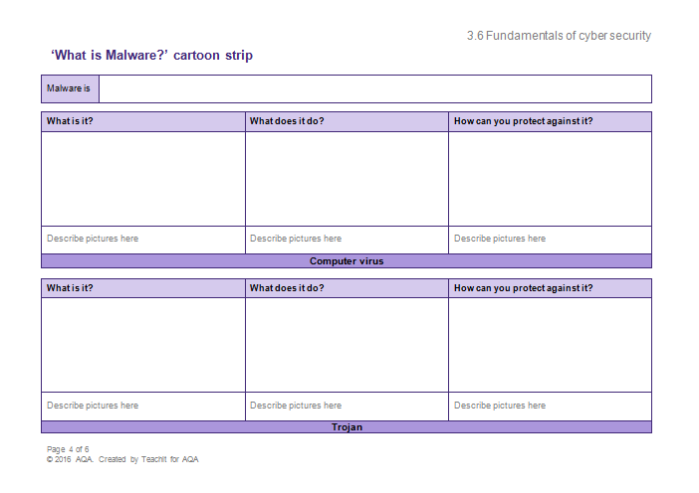
Activity: What is malware?
Create a cartoon strip for the different forms of malware.
Notes:
Students can complete the activity by hand or on the PC, and research independently in order to complete.
Extension task: Read about other malware forms such as ransomware
bbc.co.uk/news/uk-scotland-edinburgh-east-fife-35928037
Research antivirus software. Does it have limitations?

Slide 8
Plenary: Malicious code taboo
Guess the word that the person is describing – they must not use the five words on their card!

