Slide 1

3.6 Fundamentals of cyber security
3.6.1 Cyber security threats
Lesson
Notes:
Unit Objective
Be able to define the term cyber security and be able to describe the main purposes of cyber security

Slide 2
Starter activity
In pairs…
Using the cards, arrange the words into a definition of ‘cyber security’.
You have three minutes to complete the task, but you must not speak to your partner!
TIME UP
Start
Notes:
Click on ‘Start’ to start the 3 minute timer.
Answer: Protecting networks, computers, programs and data from attack, damage or unauthorised access through the use of technologies, processes and practices.

Slide 3
Starter activity: Answer
Cyber security is:
Protecting networks, computers, programs and data from attack, damage or unauthorised access through the use of technologies, processes and practices.
Notes:
http://whatis.techtarget.com/definition/cybersecurity

Slide 4
Discussion
Did you guess correctly?
What threats would organisations have to protect themselves from?
Can you think of examples of cyber security threats?
In what ways could cyber security threats be eliminated or reduced?

Slide 5
Objectives
Understand and be able to explain cyber security threats.
Explain what penetration testing is and what it is used for.

Slide 6
Cyber security threats
unpatched and/or outdated software
removable media
misconfigured access rights
weak and default passwords
malicious code
Click box to watch video
social engineering techniques
Click box to watch video
Notes:
Social Engineering techniques
Hackers use human interaction in this non-technical method of invasion. People are often tricked into disclosing information or doing something that leaves them at risk. Normal procedures for security are broken. For example a customer receives an email from their bank asking to confirm the password as they make upgrades the an account. Barclays advertising campaign 2016
www.youtube.com/watch?v=6yGvO-FefUc (0:30 minutes long)
Malicious code
This is when code is used to cause damage to a computer system or network, or cause a malfunction or breach security. The code could be part of a script e.g. Sent in an email attachment that is opened, or it could be part of a software system that is downloaded and installed. This threat is can often affect a PC or network and it can be difficult to control with only antivirus software.
http://news.bbc.co.uk/1/hi/technology/7701227.stm (BBC news article - consider printing for students to read later)
Weak and default passwords
Weak passwords are short, less than 8 characters. They are often pet’s or children’s names, birthdays or word patterns eg. qwerty or 1234567890. Many people use the same password, write it down or never change it. Some give them out to friends or co-workers (social engineering again). Default passwords (where a device leaves a factory after it has been manufactured with a default password or username) are used so the user can set up the device and change user name or password to something unique upon installation. Many users do not change the username or password and leave themselves at risk of being hacked.
Misconfigured access rights
Many people in a company have access rights to machinery or devices, e.g. a computer that is connected to the company network. People’s accounts must be configured to the correct level. As people change level in an organisation and increase or decrease their responsibilities, their account should be changed to mirror this. Often in organisations this is overlooked and can lead to people having unauthorised access to areas that should be restricted.
Removable media
In an organisation where removable media isn’t controlled an employee could use a USB stick for example to open or save an infected file onto the computer network. This could cause damage or harm and could jeopardise the organisation’s network security or data.
Unpatched and/or out of date software.
Networks and devices within an organisation should have the most up to date version of software running on them. Companies that have produced and written the software often publish updates (sometimes daily) as vulnerabilities (weakness in the software that could be exploited) are discovered.

Slide 7
Video
Watch the video clip on cyber security:
youtube.com/watch?v=sdpxddDzXfE
Notes:
Video 3:52 minutes.

Slide 8
Cyber security activity
Cyber security lab
Notes:
This is an excellent resource that demonstrates to students how an organisation can come under attack from a variety of cyber security threats. It includes programming challenges, password challenges, identification of social engineering techniques and use of removable media to threaten an organisation.
http://www.pbs.org/wgbh/nova/labs/lab/cyber/
Select – play game. Complete up to 3 levels.

Slide 9
Penetration testing
A company will identify weaknesses in their computer systems by attempting to hack into it as if they were a real cyber criminal. This can also include checking for threats from use inside of the company.
It allows a company to prevent loss and identify potential exploitation before it happens for real.

Slide 10
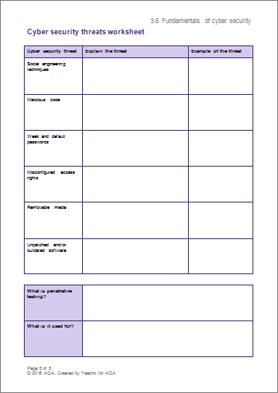
Activity
Complete the cyber security threats worksheet.
Notes:
Extension task: Find news stories with examples of organisations being attacked through these cyber security threats.
Suggest ways in which you think they could have prevented the attacks.

Slide 11
Plenary
3,2,1
Identify:
3 categories of cyber security threats
2 examples of cyber security threats
1 reason for penetration testing.

