Slide 1

3.4 Computer systems
3.4.2 Boolean logic
Lesson 3

Slide 2
Objective
Interpret the results of simple truth tables.
Create, modify and interpret simple logic circuit diagrams.

Slide 3
Starter activity
Try Quiz 1.

Slide 4
Introduction
The best way to create a diagram from a truth table using combined gates is to do the following:
Identify the possible number of inputs e.g. 1,2,3 etc
Identify the relationship between the first identified gates and inputs allowing which allows you to establish the type of logic gates are being used at the left-hand side of the diagram.
We will now look at how to identify a simple circuit using a truth table.

Slide 5
Worked example 1
 | Truth table
 | Inputs |  |  |  | Output
 | A | B | F |  | Q
 | 0 | 0 | 0 |  | 1
 | 0 | 1 | 1 |  | 0
 | 1 | 0 | 1 |  | 0
 | 1 | 1 | 1 |  | 0
For our first step, we have only the
truth table to provide us with information about the states of the inputs and output.
What do you notice about this truth table?
Look at the number of inputs and outputs.
Look at what happens to the TRUE and FALSE values.

Slide 6
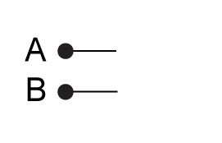
Worked example 2
 | Truth table
 | Inputs |  |  |  | Output
 | A | B | F |  | Q
 | 0 | 0 | 0 |  | 1
 | 0 | 1 | 1 |  | 0
 | 1 | 0 | 1 |  | 0
 | 1 | 1 | 1 |  | 0
How many inputs?
Because there are four total combinations of input, we can deduce that there are probably two possible initial inputs (because 2² = 4).
Draw two inputs A and B:

Slide 7
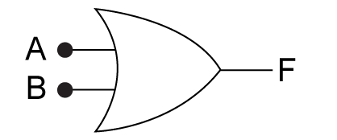
Worked example 3
 | Truth table
 | Inputs |  |  |  | Output
 | A | B | F |  | Q
 | 0 | 0 | 0 |  | 1
 | 0 | 1 | 1 |  | 0
 | 1 | 0 | 1 |  | 0
 | 1 | 1 | 1 |  | 0
What gate?
If we look at inputs A and B, we can see that the output F corresponds to that of an OR gate.
Draw the gate with an output of F

Slide 8
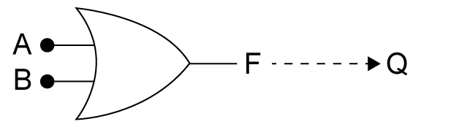
Worked example 4
 | Truth table
 | Inputs |  |  |  | Output
 | A | B | F |  | Q
 | 0 | 0 | 0 |  | 1
 | 0 | 1 | 1 |  | 0
 | 1 | 0 | 1 |  | 0
 | 1 | 1 | 1 |  | 0
F to Q?
Finally, we have one output left for which there are two clues …
one ‘input’ F to one output Q
Q is inverse of F

Slide 9
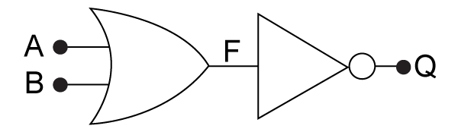
Worked example 5
 | Truth table
 | Inputs |  |  |  | Output
 | A | B | F |  | Q
 | 0 | 0 | 0 |  | 1
 | 0 | 1 | 1 |  | 0
 | 1 | 0 | 1 |  | 0
 | 1 | 1 | 1 |  | 0
Completed circuit?
From previous deduction, we have an OR gate feeding into a NOT gate!
If we draw out the above circuit then it fits the truth table’s logic state listing perfectly.

Slide 10
Over to you…
Try Quiz 2.

