Slide 1

3.1 Fundamentals of algorithms
3.1.1 Representing algorithms (abstraction)
Lesson

Slide 2
Starter activity
In pairs…
One person take a card – do not show your partner.
You have three minutes to draw the item on your card – your partner has to guess what it is.
TIME UP
Start
Notes:
After clicking on ‘Start’ the rectangle above will start to turn purple – it has been set to 3 minutes.

Slide 3
Discussion
Did you guess correctly?
How much had to be drawn before you guessed?
Does the picture look exactly like the card?
What was included?
What was left out?
Let’s think a bit harder:
What was included that wasn’t needed?
What was not included that would have made it easier to guess?

Slide 4
Objectives
Understand the term abstraction.
Be able to explain the term abstraction.
Be able to apply abstraction to problems.

Slide 5
Concepts
What we just did is known as abstraction.
It means taking away the unneeded information to leave just what is needed to solve the problem.
It is part of computational thinking which allows us to look at a problem in ways which are easier to deal with.
In the video, see if you can spot what information was taken away and what was kept.

Slide 6
Video
The creation of the Beck London Underground map:
www.youtube.com/watch?v=Bg3pfUqdLp4

Slide 7
Abstraction
What was removed?
What was kept?

Slide 8
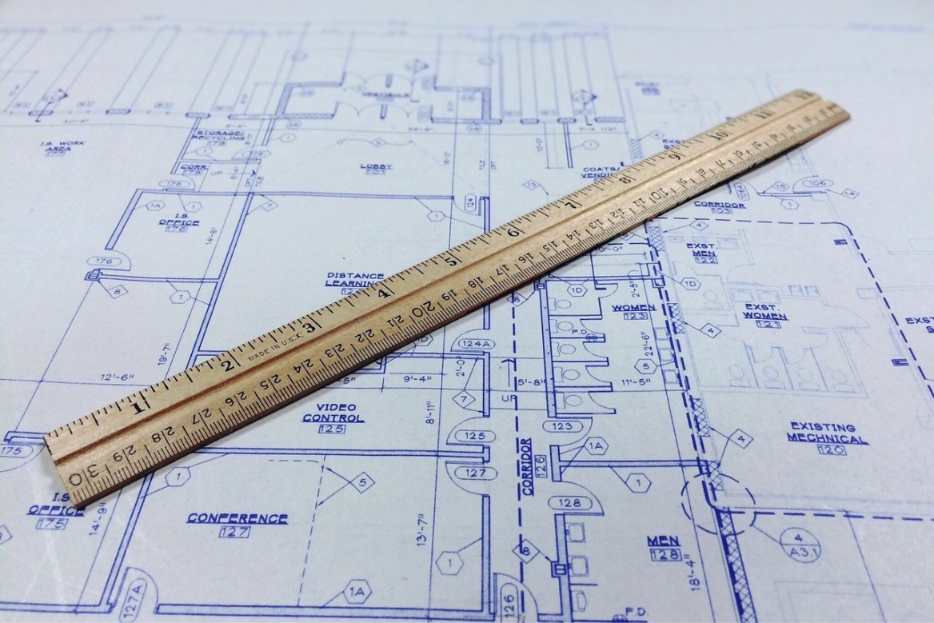
Activity
Create an abstract representation of part of the school layout.
Notes:
It would be a good idea to have a map of the school available.

Slide 9
Activity
Copy this diagram. Place your finger on point 1. You can move to any adjacent point. Find a series of moves so your finger moves to every point exactly once, returning to where it started.
1
9
6
8
3
12
2
7
4
10
5
11
Notes:
This activity is based on ‘Knight’s Tour’, made available under a Creative Commons licence (Attribution NonCommercial ShareAlike - "CC BY-NC-SA“) on http://teachinglondoncomputing.org . This license lets others remix, tweak, and build upon a work non-commercially, as long as they credit the original author and license their new creations under the identical terms. Others can download and redistribute this work just like the by-nc-nd license, but they can also translate, make remixes, and produce new stories based on the work. All new work based on the original will carry the same license, so any derivatives will also be non-commercial in nature.

Slide 10
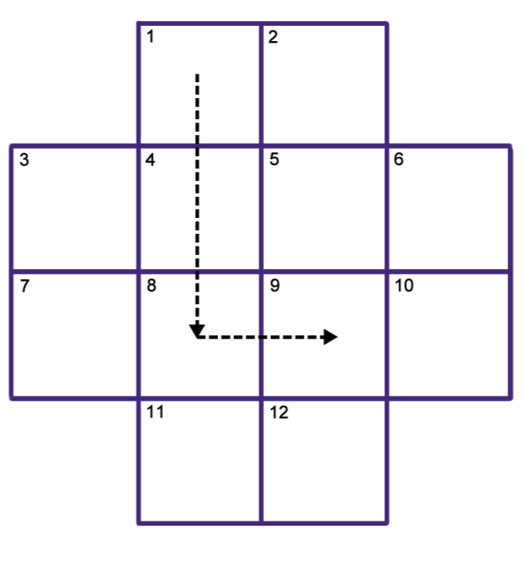
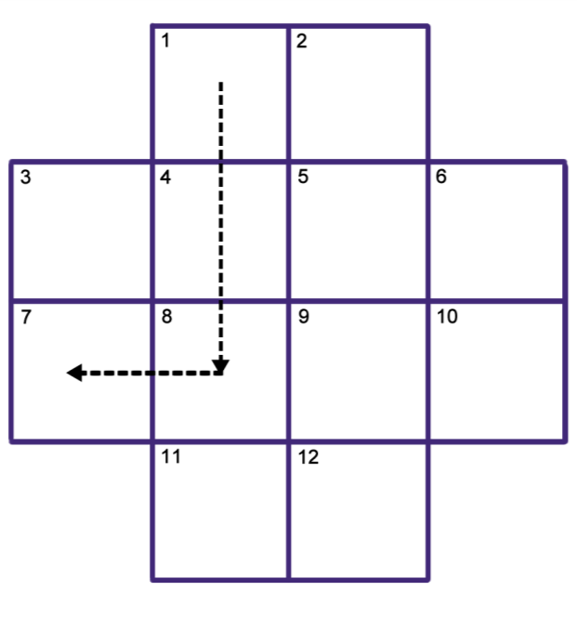
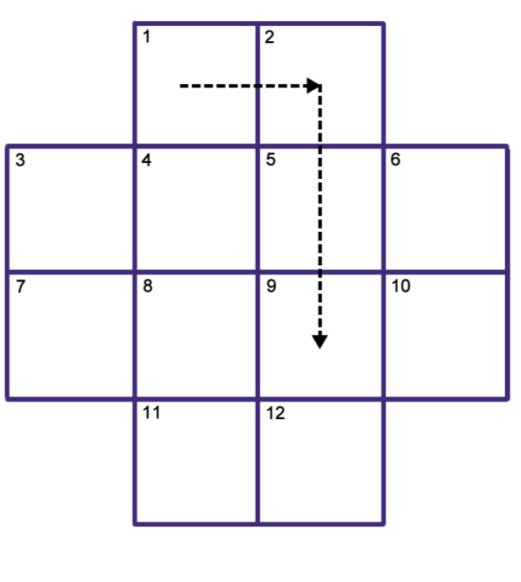
Activity
Place the Knight on square 1. By making only ‘Knight’ moves as in chess, find a series of moves so that the Knight visits every square exactly once before returning to square 1.
Extra bonus: Write a series of instructions for solving the problem.
Notes:
This activity is based on ‘Knight’s Tour’, made available under a Creative Commons licence (Attribution NonCommercial ShareAlike - "CC BY-NC-SA“) on http://teachinglondoncomputing.org . This license lets others remix, tweak, and build upon a work non-commercially, as long as they credit the original author and license their new creations under the identical terms. Others can download and redistribute this work just like the by-nc-nd license, but they can also translate, make remixes, and produce new stories based on the work. All new work based on the original will carry the same license, so any derivatives will also be non-commercial in nature.

Slide 11
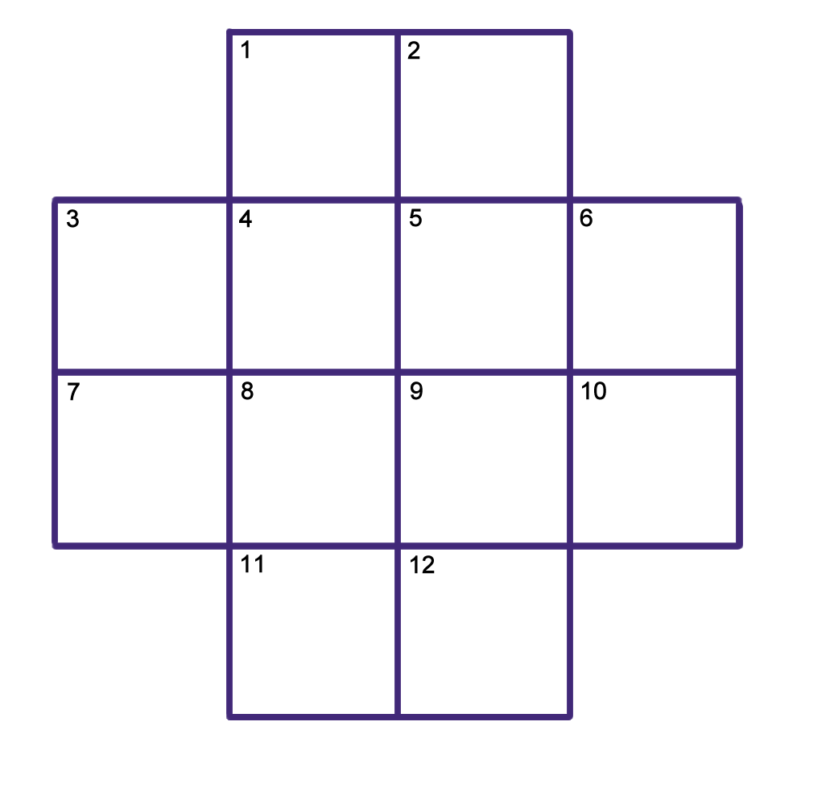
Activity
Notes:
This activity is based on ‘Knight’s Tour’, made available under a Creative Commons licence (Attribution NonCommercial ShareAlike - "CC BY-NC-SA“) on http://teachinglondoncomputing.org . This license lets others remix, tweak, and build upon a work non-commercially, as long as they credit the original author and license their new creations under the identical terms. Others can download and redistribute this work just like the by-nc-nd license, but they can also translate, make remixes, and produce new stories based on the work. All new work based on the original will carry the same license, so any derivatives will also be non-commercial in nature.

Slide 12
Discussion
Did you solve the first problem?
What about the second one?
What did you notice?
Why is this good?
This is known as abstraction by generalisation.

Slide 13
Plenary
In groups…
Write a definition of abstraction.
Write a series of top tips for anyone looking to abstract a problem.
Extension: Create a guide with your top tips for performing abstraction on a problem.
Notes:
This could be homework.

